Slide 1
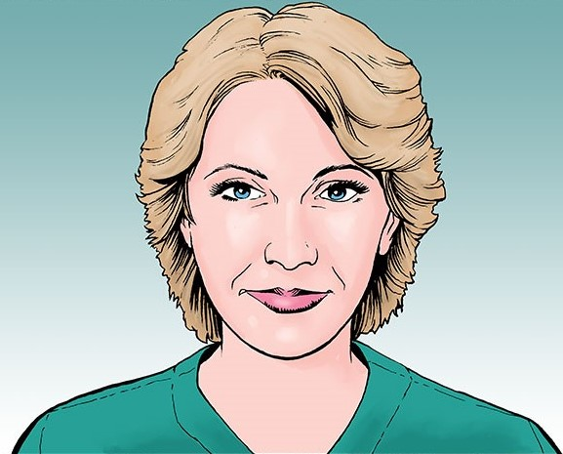
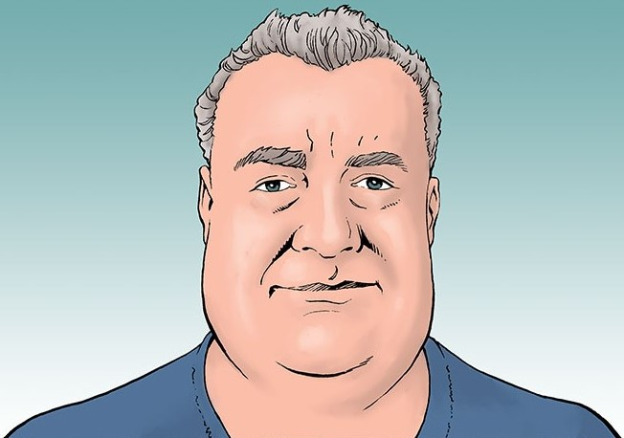
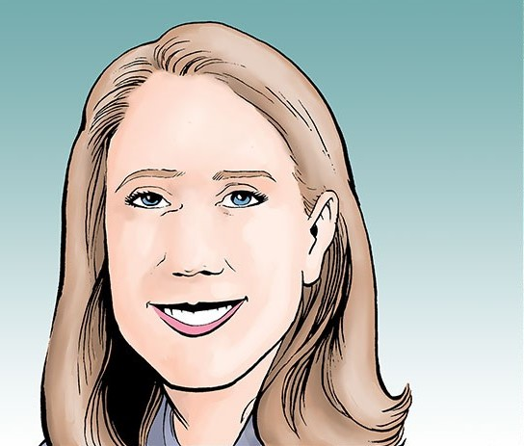
Alpha-1 Antitrypsin Deficiency (AATD) Case Studies and Expert Perspectives:
Screening, Diagnosis, and Augmentation Therapy

Slide 2
Slide Guidelines
These slides may be used in your noncommercial presentations.
When using these slides, please retain the source attribution:
For more information about the slides, please contact info@cmeology.org
Disclaimer: The information presented is not meant to serve as a guideline for patient management. Any procedures, medications, or other courses of diagnosis or treatment discussed or suggested should not be used by clinicians without evaluation of their patient’s conditions and possible contraindications and/or dangers in use, review of any applicable manufacturer’s product information, and comparison with recommendations of other authorities.
Side credit: CMEology

Slide 3
Meet Jennifer
Jennifer is a 43-year-old nursing assistant who works in an extended care facility
She has experienced intermittent dyspnea and a nonproductive cough over the past 4 years
Former smoker who quit 10 years ago
In recent years, seen by 3 other physicians about her dyspnea and was treated for suspected asthma with an albuterol inhaler
Presents at your clinic with worsening dyspnea and wheezing, especially when providing physical care for patients
Initial test results:
FEV₁/FVC ratio 65%
Chest x-ray normal
FEV₁, forced expiratory volume in 1 second; FVC, forced vital capacity.
Notes:
S

Slide 7
Meet Will
Will is a 52-year-old male who works as a manager at a home-improvement store
He presents to your clinic with complaints of nausea, fatigue, and abdominal discomfort
Has had similar symptoms on and off for the past year but has put off going to the doctor
History:
Smokes cigarettes (1 pack per day) and has a beer or cocktail about 5x/week
Bronchitis; hospitalized 2 years ago for pneumonia
No family history of liver disease
Clinical evaluation reveals:
Obesity
Abdominal swelling
Elevated ALT, AST, and bilirubin levels
ALT, alanine transaminase; AST, aspartate aminotransferase.
Notes:
C

